Slide 1
FEMA TRAVEL REGULATIONS AND POLICIES
COURSE GOAL
To prepare FEMA employees to be prudent travelers and abide by the agency travel regulations

Slide 2
Objectives
Explain the Prudent Traveler Rule
Arrange for travel as prescribed by the regulations
Differentiate between local and out-of-area travel
Use the government travel card in compliance with the rules

Slide 3
Objectives
Describe lodging expense limits
Explain the meals and incidentals expense allowance
Discuss travel bonus programs and government travel
Determine which expenses are reimbursable
Identify what receipts are required for reimbursement

Slide 4

BASIS OF TRAVEL FUNDING
Federal Travel Regulations
FEMA Travel Policy
Modifications by CFO Bulletins
CFO Bulletin

Slide 5
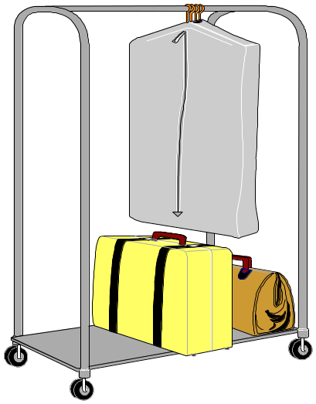
Purpose of Travel Funding
Provide adequate subsistence for expenses incurred on official government business

Slide 6

Regulations...
Set equitable expense limits
Ensure fair reimbursement to employees
Limit types of expenses paid by appropriated funds

Slide 7
Prudent Traveler Rule
“An employee on official business is expected to exercise the same care in incurring expenses that a prudent person would exercise if traveling on personal business.”

Slide 8
TRAVEL AUTHORIZATION
Travel Authorization specifies:
  Where travel is to occur (locations)
  What expenses are authorized
  When travel will occur (dates)
  Who is to travel
  Why travel (purpose)
  How (mode of transportation)

Slide 9

Travel Authorization (TA)
Travel Authorization (TA) characteristics:
  Single, group or invitational
  Combined TA (Disaster)
  Signed by approving official
  Has a number!
Get the number and get your copy!

Slide 10
Travel Reservations
Use National Travel Management Center (TMC):
  Regional or Headquarters contracted travel agency
  Service available 24 x 7
  Toll-free phone number 1-800-294-8283
Do NOT use an independent agent

Slide 11
Travel Reservations
Obtain government rates
Rates must be guaranteed
Purchase refundable tickets
Designate coach class travel only

Slide 12
Private Occupancy Vehicle (POV)
May use POV if approved on the TA
FEMA cannot require you to use your POV
Reimbursement for your POV may not exceed common carrier travel

Slide 13
Per Diem Reimbursement
Includes Lodging and Meals & Incidental Expenses (M&IE)
Set by GSA for continental U.S. (CONUS)
Set by:
  Dept of Defense for territories
  State Department for OCONUS

Slide 14

Lodging
  Reserve through National Travel (except FEMA facility)
Reimbursement at approved rate only
Attach fully paid receipt to claim form (zero balance)

Slide 15

LODGING
Regional Directors, Administrators,
Office Heads (GC, IG) authorize up
to 150% of government rate
CFOs authorize from 151% -- 300%
Nothing above 300%

Slide 16
Meals & Incidental Expenses
Flat rate - no receipts required
First and last day of travel at 75% of allowance for site
Rate reduced by cost of included meals, such as at a conference

Slide 17
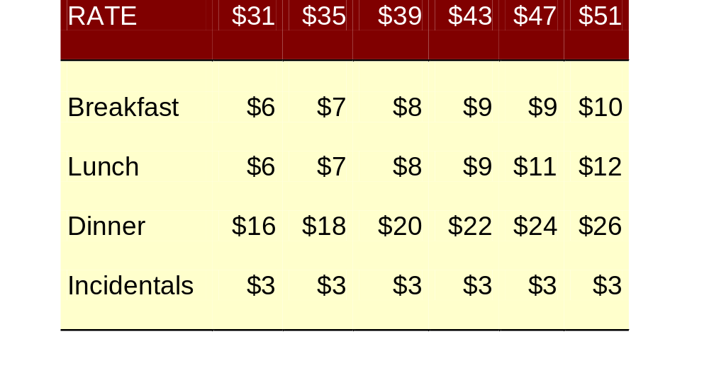
Meals & Incidental Expenses
FY-2004

Slide 18
Travel Bonus Programs
You may keep for personal use:
  Frequent Flyer Miles
  Hotel Frequent Guest Programs
  Rental Car Upgrades
If no additional cost to government
You may keep, with conditions, vouchers for voluntarily vacating a seat

Slide 19
Government Travel Card
Must be used:
    During the designated travel period
    For eligible items
    For cash withdrawals, if approved on the TA
      ATM fees of 1.25% are reimbursable, with receipt

Slide 20
Government Travel Card
You must pay the balance in 30 days
Cards with non-payment for:
  60 days will be suspended
  120 days will be cancelled and credit card company will assess an interest penalty

Slide 21

Eligible expenses
Transportation to & from airport
Official phone calls
Personal phone calls
Rental cars, if on TA
Laundry (must incur expense)
ATM fees

Slide 22
Non-reimbursable Expenses
Tips
Laundry & dry cleaning outside the continental U.S.
Car washes, locksmiths, fuel surcharge, drop-off fees (rental cars)

Slide 23
Local Travel
Within 50-mile radius of official duty station (may be up to 100 miles)
DAEs have special regulations when DFO within 50 miles of residence

Slide 24
Receipts Required
Cash expenditures over $25 for allowable expenses
Fees relating to travel outside the continental United States
Room rental for official business
Services of guides and interpreters
Freight shipments

Slide 25
Receipts Required
Business telephone calls
Clerical assistance
ATM fees
Parking fees
Tolls
Rental car and gasoline

Slide 26
Travel Vouchers
File every two weeks, if on extended travel (disaster, etc)
File within 5 days of end of trip
Get appointment with DFO travel manager
Prepare receipts
Reimbursement will be direct deposit

Slide 27
SPLIT PAY
Under split pay, FEMA reimburses traveler’s govt. credit card account for air, rail, and bus; lodging and taxes; rental vehicles; ATM fees and TMC transaction fee.
Remainder of reimbursement is sent to traveler’s bank account.
Travelers will receive a bill which reflects FEMA’s reimbursements, then travelers pay remaining balance.

Slide 28
Summary
Now you should be a Prudent Traveler, prepared to travel within the framework of the rules and regulations and capable of filing your travel claims with correct documentation.

